Slide 1
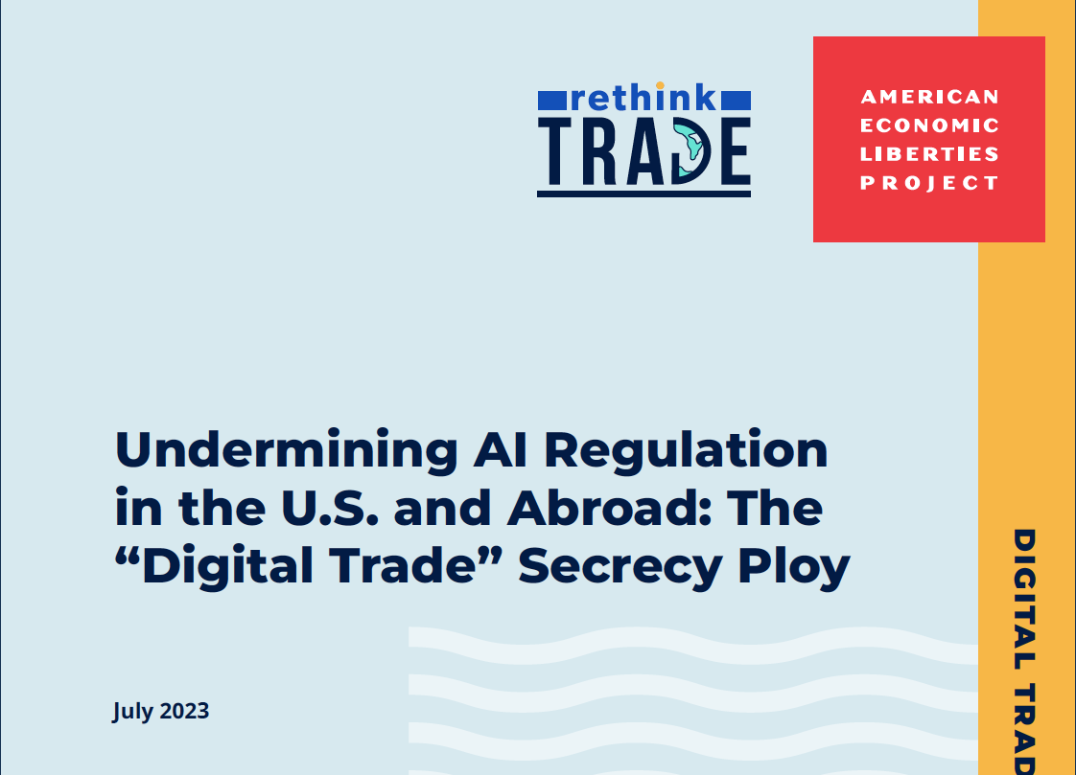
Daniel Rangel, Research Director

Slide 2
Artificial Intelligence Is Everywhere These Days, But It Goes Beyond ChatGPT and other Gen AI tools…
Automated decision systems (ADS) are widely used and until now have a larger impact on everyone’s daily lives. AI is used to make decisions around:
Hiring and workplace management
Home loan or insurance coverage
Criminal justice system and law enforcement
Pricing and supply management
Access to public and private services and more…
Underpinning these AI systems are a few core elements:
large amounts of data,
algorithms that process such data, and
computational power.
The algorithm, expressed in a way that humans can understand
it, is what people refer to as “source code.”

Slide 3
Widespread Use of AI Has Resulted in Demonstrated Harms
AI systems have led to a range of demonstrated harms including inaccuracies or biases that disproportionately affect women, people of color, or people with disabilities.
Examples of AI harms include:
Biased policing
Employment discrimination
Worker surveillance
Unfair lending
Housing discrimination
Monopolistic self-preferencing & collusion
Price discrimination
Biases and other harms often stem from decisions around the training data or the design of the algorithmic model itself, as embedded in its source code.

Slide 4
AI Harms Have Led to a Call for Algorithmic Transparency and Accountability
After documenting and studying these harms, researchers and policy experts started calling for algorithmic transparency and accountability.
Some tools include:
Strong documentation requirements
Mandatory and verifiable impact
assessments
Pre-deployment testing
Third-party audits
Implementing these policies requires
governments’, researchers’, and auditors’
access to key algorithmic
information, sometimes that
includes source code.

Slide 5
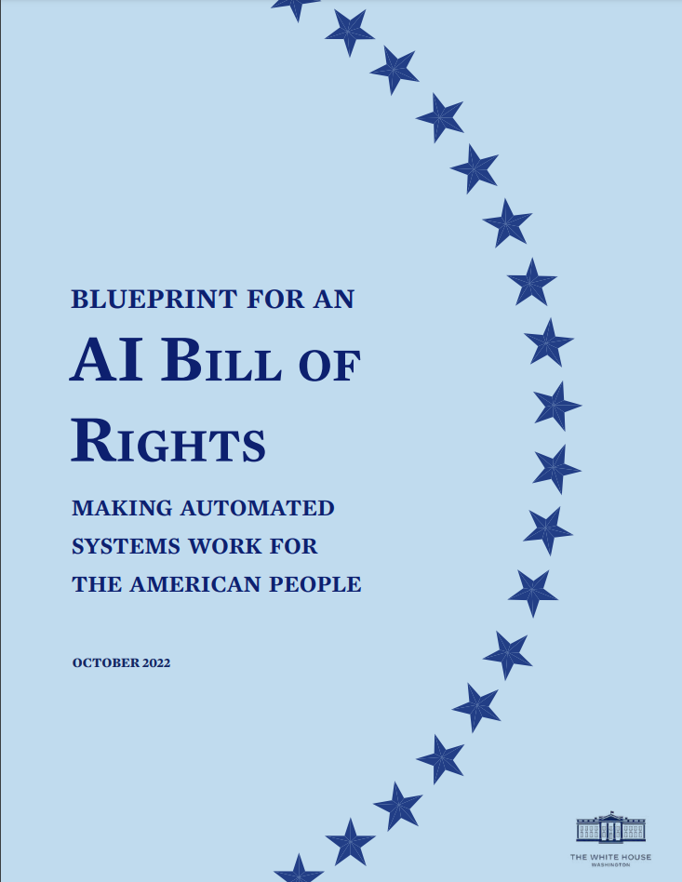
The Blueprint for an AI Bill of Rights recommends:
Pre-deployment testing
Risk identification and mitigation
Ongoing monitoring
Independent evaluations
Algorithmic impact assessments
The American Data Privacy and Protection Act’s (ADPPA) title on “civil rights and algorithms” would require impact assessments and algorithm design evaluations to be submitted to the FTC.
In Europe, the AI Act would impose requirements on AI developers and grant enforcement authority to national agencies.

Slide 6
So, How is this Related to “Digital Trade”?
Answer: Corporations Want to Include Source Code and Algorithmic Secrecy Guarantees in Trade Deals
“USMCA Article 19.16: Source Code
1. No Party shall require the transfer of, or access to, a source code of software owned by a person of another Party, or to an algorithm expressed in that source code, as a condition for the import, distribution, sale or use of that software, or of products containing that software, in its territory.
2. This Article does not preclude a regulatory body or judicial authority of a Party from requiring a person of another Party to preserve and make available the source code of software, or an algorithm expressed in that source code, to the regulatory body for a specific investigation, inspection, examination, enforcement action, or judicial proceeding, subject to safeguards against unauthorized disclosure.”
The USMCA prohibition covers “an algorithm expressed in that source code.” USMCA Art. 19.1 defines algorithm as: “a defined sequence of steps, taken to solve a problem or obtain a result.” → This prohibition encompasses not only source code, but the design for solving a problem or obtaining a result. The ban on government access could cover descriptions of algorithms, not just source code.

Slide 7
Industry’s Objective Is to Include These Terms in the Indo-Pacific Economic Framework Negotiations (IPEF)…
… But only 11 of 181 agreements with digital trade or e-commerce terms include secrecy guarantees for source code.
Source: TAPED dataset, “The Governance of Big Data in Trade Agreements,” Universities of Lucerne and Bern.

Slide 8
Algorithmic Transparency and Accountability Policies Undercut by Source Code and Algorithm Secrecy Provisions
Horizontal Policies | • White House Blueprint for an AI Bill of Rights • American Data Privacy and Protection Act (ADPPA) Rules on Civil Rights and Algorithms • Algorithmic Accountability Act of 2019
Area-Specific Policies
 | Criminal Justice System and Law Enforcement | Fair Lending and Housing | Labor and Employment Law | Anti-Monopoly and Competition Policy
Federal | • Justice in Forensic Algorithms Act of 2021 • Facial Recognition and Biometric Technology Moratorium Act of 2023 • Facial Recognition Act of 2022 | • Biden Administration's Rulemaking on Property Appraisal and Valuation Equity • Obama Administration's Report on Algorithmic Systems, Opportunity, and Civil Rights | • Stop Spying Bosses Act of 2023 | • Department of Transportation's Algorithmic Disclosure Requirements for Computer Reservation Systems (CRS)**
State | • Idaho's Criminal Procedure Rule on Pretrial Risk Assessments*
 | • Washington's Guidelines on Government Procurement and Use of Automated Decision Systems
Local | • Washington D.C.'s 2023 Stop Discrimination by Algorithms Act
How Bad Would It Be if Special Secrecy Guarantees Becomes the Global Standard?

