Slide 1


25 Years of IPD Conference
Panel 7: Market and Political Power in Economics, Artificial Intelligence, and the New Digital Rules
Lori Wallach
Director, American Economic Liberty Project’s Rethink Trade
LWallach@RethinkTrade.org www.RethinkTrade.org X/Twitter: @WallachLori

Slide 2
Asymmetries in Rulemaking and Enforcement Not Only By
Country but Interest: Why Commercial Lobbies Target “Trade”
Talks & Pacts to Impose Policies Unpopular in Democratic Venues
Closed-door negotiations, secret texts: 500 corporate advisors in US (See “Loaded” at RethinkTrade.org - a chart of interests) public, press, to a degree Congress excluded.
Lock-in: No changes without consensus of all signatory nations if in agreements. Built-in lobby of angry consumers if enforcement is via tariffs. Thwarts democratic accountability, response to emerging problems.
Binding & enforceable when in agreements: Unlike most labor, environmental, human rights treaties, trade-pact & investment treaty rules enforced in extra-judicial tribunals. Nations must change policy or face trade sanctions and w/ ISDS, pay investors cash.
Establishes a global model: Either in one fell swoop via global or large plurilateral agts or by rolling back other nations’ better policies region by region to set a de facto norm
What is the “US” interest represented when Big Tech agenda is pushed... What “European” interest was represented when EU blocked COVID TRIPS waver…

Slide 3
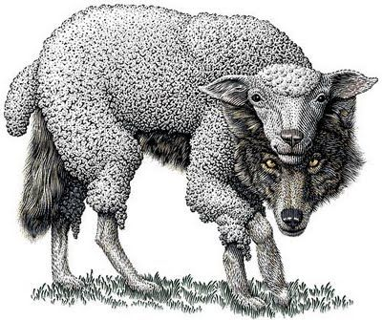
Big Tech Borrows a Page from Pharma’s Playbook
as Governments Move to Regulate: Online Privacy and
Civil Rights & Liberties, Worker Protections and
Competition Policy Threatened by Industry “Digital Trade” Ploy
In WTO, Big Pharma locked in a global 20-year patent monopoly period for expansive items
Starting with the Trans-Pacific Partnership, U.S. Big Tech lobbyists began trying to insert non-trade deregulatory terms into the “E-Commerce” chapters.
Big Tech lobbyists created “digital trade” brand. The reality Is international preemption of
tech oversight via “trade” agt. See: American Prospect: “Big Tech Lobbyists Explain How They Took Over Washington” based on “Regulatory Capture’s Third Face of Power,” Wendy Li, Oxford Socio-Economic Review
Initially sold w/ rhetoric about “free flow” of data being same as “free speech” or “beating” the Chinese or fighting ‘jealous’ European effort to squelch US innovation. Now Trump openly pushing Big Tech interests (“our beautiful tech companies”) as U.S. national interest.
Trump’s USMCA is ONLY US pact with the full set of the Big Tech-favored “Digital Trade” rules. (See USMCA Chap. 19)

Slide 4
Public Interest Digital Sphere Safeguards, Platform Accountability Goals and Policies Threatened by Industry “Digital Trade” Ploy
AI regulation, prevention of online discrimination, prevention of bossware violations, Right to Repair, gig worker labor rights, and promotion of other civil rights and liberties
New secrecy guarantees for source code & algorithms​ thwart AI pre-deployment evaluations and impact assessments, Right to Repair access to digital keys, algorithmic specifications
  Online privacy, data security/national security, data disgorgement antitrust remedies ​
Governments banned from limiting platforms’/data brokers’ control of personal data, including rights to move, process, and store personal data wherever the firms choose
  Competition policy & labor/consumer protection that may affect bigger firms more
  ”Discriminatory effect” standard hits laws that apply to domestic and foreign firms but target by market dominance or could impact foreign firms because they are dominant/large: AICOA/DMA, Open App Mkts/Korea App Store Law, JCPA/Canada & Oz Media Bargaining Codes
Platform liability waiver (Lock-in and export of U.S. “Sec. 230” )​
  Big Tech interests have conceded this provision for the timebeing

Slide 5

The USMCA digital trade model promoted by industry conflicts with digital governance proposals in the U.S.
and elsewhere
In this report, we examined four of the most problematic USMCA digital trade provisions that conflict with congressional and White House initiatives. These include:
Secrecy guarantees for algorithms and code
(USMCA Article 19.16 (Source Code))
Unfettered control of data by industry, including powers to move, process, and store personal data.
(USMCA Art. 19.11 (Cross-Border Transfer of Info by Electronic Means)) and Article 19.12 (Location of Computing Facilities))
Designation of anti-monopoly policies, facially neutral laws that could have more impact on bigger firms as Discriminatory Illegal Trade Barriers
(USMCA Article 19.4 (Non-Discriminatory Treatment of Digital Products))

Slide 6
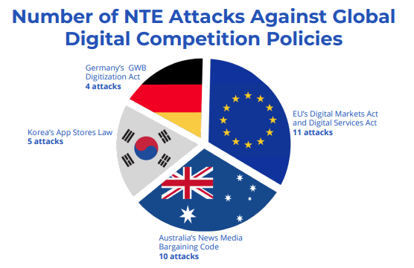
Hijacking of trade language and concepts
to distract from actual goals and agenda
Trade attacks via National Trade Estimates (NTE) process targeting origin-neutral policies countering monopoly power as “discriminatory” trade barriers:
Korea’s App Stores Law that, like S2730/H5017 Open App Markets Act, promotes increased competition by requiring app stores to allow diverse payment systems, cross-store listing
Australia’s News Media Bargaining Code similar to S673/H1735 JCPA counters Facebook-Google monopolization of ad revenue & resulting decimation of local journalism by creating conditions for digital platforms to pay for news they distribute
EU’s Digital Markets Act & Digital Services Act
Germany’s GWB Digitization Act aimed at preventing monopoly conditions
Rethink Trade Report: “Digital Trade” Doublespeak: Big Tech’s Hijack of Trade Lingo to Attack Anti-Monopoly and Competition Policies

Slide 7

“Digital Trade” Is a Brand Designed To Sound
More Appealing than “No Regulation of Big Tech”
To globalize Big Tech’s demands, Trump submitted USMCA “digital trade” rules as a WTO proposal in 2019. Few countries outside TPP had such constraints in trade pacts and opposed.
Most countries have less absolutist “digital trade” rules. EU had a smart data flow-privacy rule that’s being eroded. Big Tech got bad terms in 55-nation African Continental Free Trade Area.
Biden admin. withdrew USMCA terms from US proposal at WTO in ‘23. WTO E-Commerce deal ‘initial harvest’ done w/o worst items. Biden “IPEF” excludes these terms. Big Tech goes nuts.
Trump back to bad old but even also doubling down, now with direct tariff threats.
Not a Hypothetical Problem
EU AI Act watered down by European Trade Agency “DG Trade” claiming UK-EU Free Trade Agt requires this. See, EuroActiv, ”How trade commitments narrowed EU rules to access AI’s source codes“ (May 2023)
Indonesia, other nations offer to weaken digital laws to evade tariff threats

Slide 8
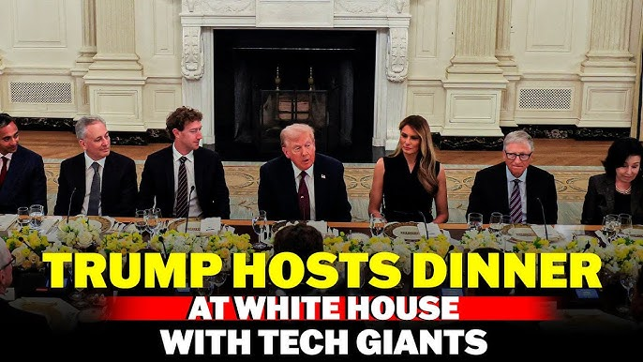

Slide 9
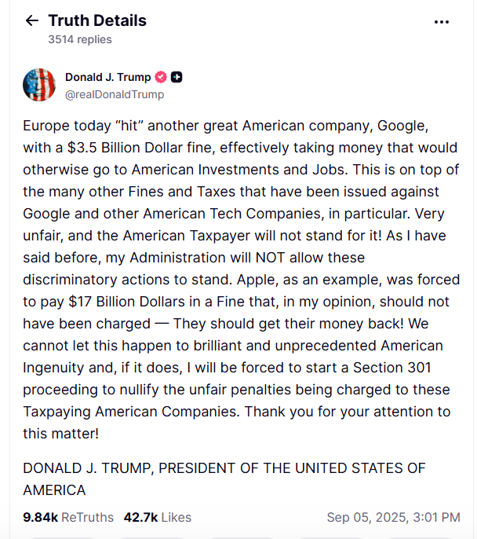
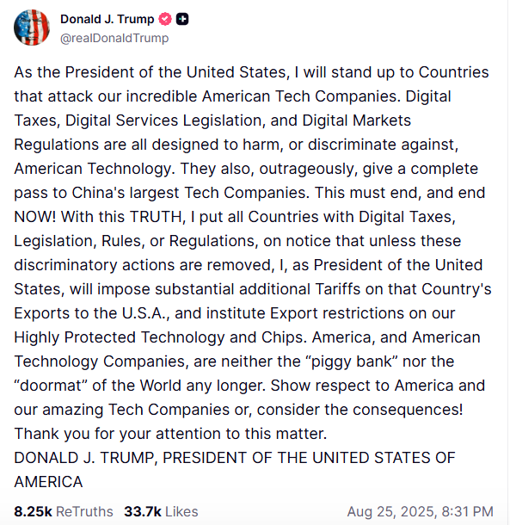
Trump Tariff Threats Against Digital Regs on Behalf of Big Tech

Slide 10
Enormous Implications for Global Economy – and Democracy if Big Tech Giants Operate Outside Public Interest Safeguards, Accountability
This global backdoor attack in trade camouflage must be countered, repelled, and reversed.
EU should take note during Trump current attack against Big Tech oversight: Trump “blinked” when China pushed back, revealing weakness of the bully
Post Trump, not only a matter of what NOT to do. But what rules we need to achieve more fair, resilient, balanced and green trade and what “grand bargain” among what set of countries could start such a regime
  Good to hear EU officials saying EU digital policy is not up for negotiation, is a sovereign right.
  But, will there be weaker enforcement while on surface the right things are said?
  EU not pushing back, not threatening trade “bazooka”…Geopolitics of Ukraine beyond usual Germany export fixation… But, worth noting China escalated and Trump could not stomach stock/bond market rollercoaster.
Trump is playing with political fire with this trade attack for Big Tech: One thing Americans agree across political divides: Big Tech has too much power and use it to abuse the rest of us – destroying our privacy, crushing smaller American businesses, price gouging, making it impossible for us to repair the stuff we own. Trump promised he would use tariffs to restore American manufacturing, but instead every week Trump tells another country he will hit them with tariffs if they do not kill their laws against Big Tech abuses. Just since Trump came back to office, we have lost 78,000 American manufacturing jobs while Trump invites the Big Tech oligarchs who showered him with campaign cash to the White House for dinner and fired out more tariff threats against countries’ Big Tech anti-monopoly laws.

Slide 11
Trump “Discrimination” Claim, Trade-Pact Digital Product “Non-Discrimination” Rules Ensnares Facially Neutral Anti-Monopoly, Labor, Consumer Safety Policies
Korea-US FTA differentiates de jure vs. de facto discrimination
Article 15.3: Digital Products
… 2. Neither Party may accord less favorable treatment to some digital products than it accords to other like digital products
(a) on the basis that: [Note: Subparagraphs (i) and (ii) refer to de jure discrimination claims.]
(i) the digital products receiving less favorable treatment are created, produced, published, stored, transmitted, contracted for, commissioned, or first made available on commercial terms in the territory of the other Party, or
(ii) the author, performer, producer, developer, distributor, or owner of such digital products is a person of the other Party; or
(b) so as otherwise to afford protection to other like digital products that are created, produced, published, stored, transmitted, contracted for, commissioned, or first made available on commercial terms in its territory.
[Note: The “or” and “so as otherwise to afford protection” clause is intended to differentiate that for de facto discrimination claims, discriminatory intent must be proven. WTO tribunal rulings have since undermined this clause’s meaning. So, to be reliable, new clarifying language would be needed that explicitly requires a showing of intent. But as a general matter, a refined differentiated approach can preserve policy space and catch real discrimination]
USMCA conflates de jure & de facto Article 19.4: Non-Discriminatory Treatment of Digital Products
1. No Party shall accord less favorable treatment to a digital product created, produced, published, contracted for, commissioned, or first made available on commercial terms in the territory of another Party, or to a digital product of which the author, performer, producer, developer, or owner is a person of another Party, than it accords to other like digital products.³ ³ For greater certainty, to the extent that a digital product of a non-Party is a “like digital product,” it will qualify as an “other like digital product” for the purposes of Article 19.4.1 (Non-Discriminatory Treatment of Digital Products). [Note: This broad standard treats de facto and de jure discrimination claims the same: If a policy has greater impact on some firms/digital services than others, it is considered discriminatory even if the reason is size of the firm, or business choices by the firm and the different impact is unrelated to nationality.]

Slide 12
Trump weaponizes “Non-discrimination” for “digital products” weaponized to challenge competition policies
INDUSTRY DEMAND:
USMCA Art. 19.4 “Non-Discriminatory Treatment of Digital Products Language that Treats Laws that Do not Discriminate on basis of Nationality as Illegal Trade Barriers
EU’s Digital Markets Act
South Korea, Japan
App Store Laws
Canada’s Online News Act & Australia’s News Media Bargaining Code
American Innovation and Choice Online Act
Open App Markets Act
Journalism Competition and Preservation Act
EU’s Digital Services Act
ACCESS Act of 2021
(Augmenting Compatibility & Competition by Enabling Service Switching)
Algorithmic Justice and Online Platform Transparency Act
Germany’s GWB Digitization Act
Prohibiting Anticompetitive Mergers Act

Slide 13
USMCA-Style “SOURCE CODE” Rules Would Undermine 17 US States’
Right to Repair Laws, Thwart General Audits or Screening of Algorithms
& Code for Racial Bias, Labor Law Abuses, or Other Violations
USMCA Article 19.16: Source Code 1. No Party shall require the transfer of, or access to, a source code of software owned by a person of another Party, or to an algorithm expressed in that source code, as a condition for the import, distribution, sale or use of that software, or of products containing that software, in its territory. 2. This Article does not preclude a regulatory body or judicial authority of a Party from requiring a person of another Party to preserve and make available the source code of software, or an algorithm expressed in that source code, to the regulatory body for a specific investigation, inspection, examination, enforcement action, or judicial proceeding,⁶ subject to safeguards against unauthorized disclosure. [Emphasis added] ⁶ This disclosure shall not be construed to negatively affect the software source code’s status as a trade secret, if such status is claimed by the trade secret owner.
- USMCA Art. 19.1 defines algorithm as “a defined sequence of steps, taken to solve a problem or obtain a result.” So the prohibition on gov’t access covers not only source code developed by programmers, but the design and descriptions of algorithms - the algorithm assessments required in ADPPA’s civil rights terms & other bills!
- The “specific” investigations “exception” precludes the general pre-screening called for in the AI EO & many bills.
- WTO’s Trade Related Aspects of Intellectual Property (TRIPS) Agt. ALREADY requires China & all WTO nations to provide trade secrets protection for business confidential info, including source code & algorithms. (Art. 39) Additional secrecy rights on paper won’t change China’s misconduct, it will just prohibit rule-of-law countries from digital oversight. Perhaps stronger US enforcement of the existing rules might improve the situation…

Slide 14

Extreme algorithmic and source code secrecy rules threaten algorithmic justice and accountability
INDUSTRY DEMAND : USMCA Article 19.16: Source Code AND Algorithm Secrecy Guarantee
Law enforcement and criminal justice
reform bills
Facial Recognition Act of 2022*
Facial Recognition and Biometric Technology Moratorium Act of 2021
Justice in Forensic Algorithms Act of 2021*
Impact assessments & algorithm design evaluations
NIST & third-party testing
NIST testing & source code access for defendants
Auditing requirements
Qualified data access for researchers
Independent evaluation and reporting – algorithmic impact assessments
Platform Accountability and Transparency Act
17 U.S. States Right to Repair Laws
* Proactive external monitoring obligations
https://rethinktrade.org/wp-content/uploads/2023/07/AELP_RethinkTrade_AIAccountability.pdf

Slide 15
Tech Firms’ Control of User Data, Including Rights to Move, Process, and Store Personal Data Wherever the Firms Choose
USMCA Article 19.12: Location of Computing Facilities No Party shall require a covered person to use or locate computing facilities in that Party’s territory as a condition for conducting business in that territory. USMCA Article 19.11: Cross-Border Transfer of Information by Electronic Means 1. No Party shall prohibit or restrict the cross-border transfer of information, including personal information, by electronic means if this activity is for the conduct of the business of a covered person. 2. This Article does not prevent a Party from adopting or maintaining a measure inconsistent with paragraph 1 that is necessary to achieve a legitimate public policy objective, provided that the measure: (a) is not applied in a manner which would constitute a means of arbitrary or unjustifiable discrimination or a disguised restriction on trade; and (b) does not impose restrictions on transfers of information greater than are necessary to achieve the objective.⁵ ⁵ A measure does not meet the conditions of this paragraph if it accords different treatment to data transfers solely on the basis that they are cross border in a manner that modifies the conditions of competition to the detriment of service suppliers of another Party.]
The GATT “Art. XX” exception on which USMCA Art.19.11.2 is based & from whence come the highlighted words/clauses above and related standards established in WTO jurisprudence, were allowed in 2 of 48 attempts…
See: Daniel Rangel, “WTO General Exceptions: Trade Law’s Faulty Ivory Tower,” Public Citizen Jan. 2022. p.18-19. Available at: https://www.citizen.org/article/wto-general-exceptions-trade-laws-faulty-ivory-tower/.

Slide 16

Unfettered guarantees of no government policy on where data can be sent or stored limits privacy, data security policies
INDUSTRY DEMAND - USMCA Article 19.11: Cross-Border Transfer of Information by Electronic Means & Article 19.12: Location of Computing Facilities
Data Brokers Law passed 2024 that forbids sale/movement of US data to countries of concern
U.S. government requirement that cloud computing contractors store data in U.S.
Bills: My Body, My Data and Fourth Amendment Is Not For Sale Act
Individual rights (access, control, delete)
Data storage security for sensitive infrastructure
Data brokers obligations
American Data Privacy and Protection Act
Data controller obligations
Data security/export controls
https://rethinktrade.org/wp-content/uploads/2025/05/Digital_Heist_report_updated.pdf

